Slide 1


OPEN Business Models and User Innovation
Prof Kristofer Erickson
Kristofer.Erickson@Glasgow.ac.uk
4 March 2026
Photo: @levelsix @jlitzphoto

Slide 2
Schedule
(6) | 4 March | Open Business Models | Erickson
(7) | 11 March | GLAM, Preservation and TPMs | Erickson
(8) | 18 March | NFTs and Virtual Worlds (Metaverse) | Erickson
(9) | 19 March | Traditional Knowledge | TBD

Slide 3
IP may be “Open” because:
The legal scope of IP protection doesn’t cover the thing owners want to protect;
Because applying IP law would negatively impact the activity participants are trying to undertake.

Slide 4
This session
Part 1: Negative spaces
When copyright doesn’t apply
When both cases are true: Law vs. social norms
Commons and anti-commons
Part 2: Examples of open innovation
How creative firms can profit without copyright or IP ownership
Group Business Model Challenge

Slide 5
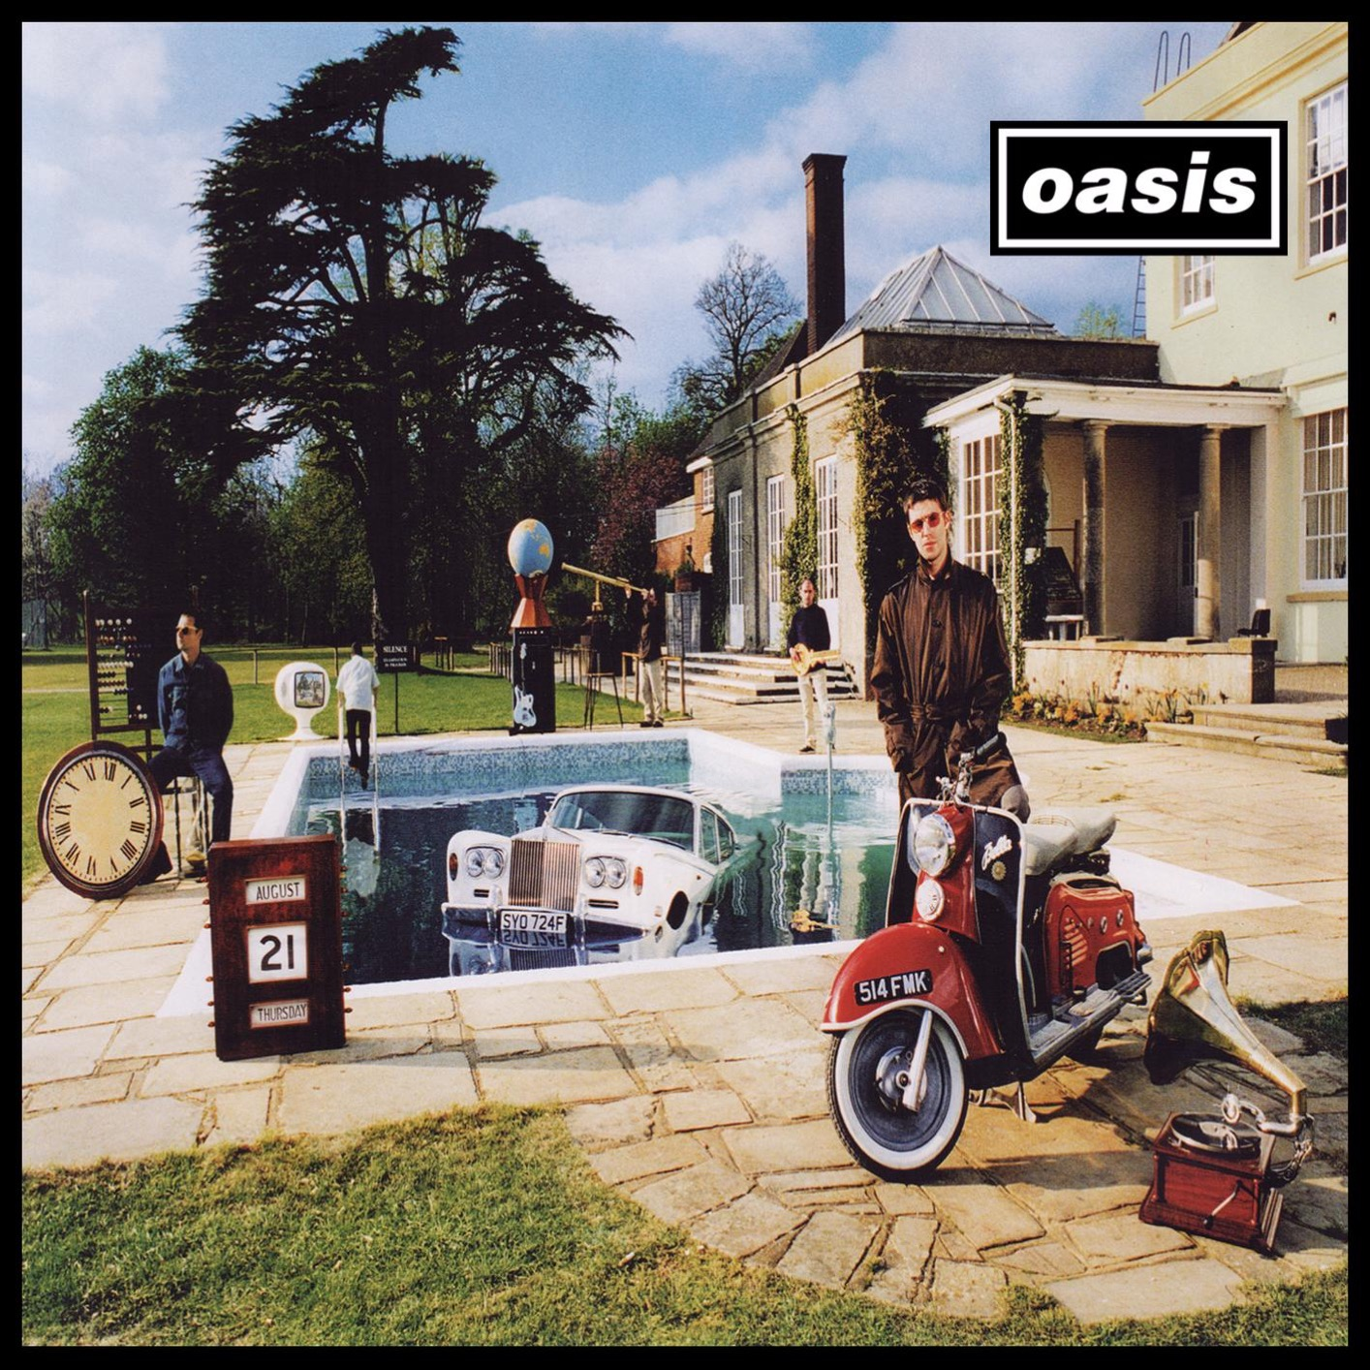
1. Lack of protection: subject matter & idea/expression dichotomy
CDPA (1988)
(i) literary works;
(ii) dramatic works;
(iii) musical works;
(iv) artistic works;
(v) films;
(vi) sound recordings;
(vii) broadcasts;
(viii) published editions (or typographical works).
What counts as a “work”?
e.g. Creation records

Slide 6
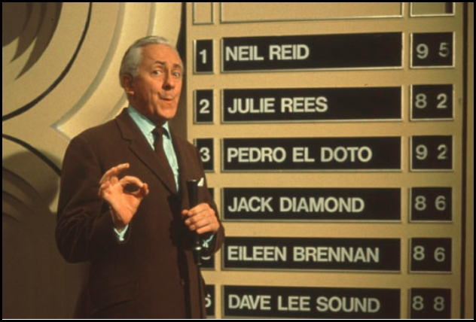
Dramatic works
CDPA 1988: “Capable of being performed”
Must be a unitary performance ,e.g. not only the conditions to perform (Bently et al p. 75)
-A diet or exercise routine?
-A TV game show format?
-A video game mechanic? (See Nova Prod v Mazooma Games)
Green v Broadcasting Corp. Of NZ [1989]

Slide 7


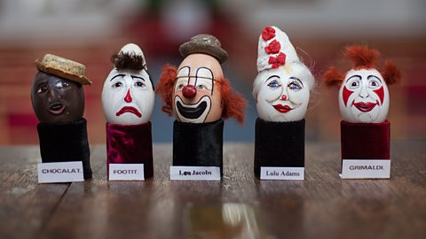
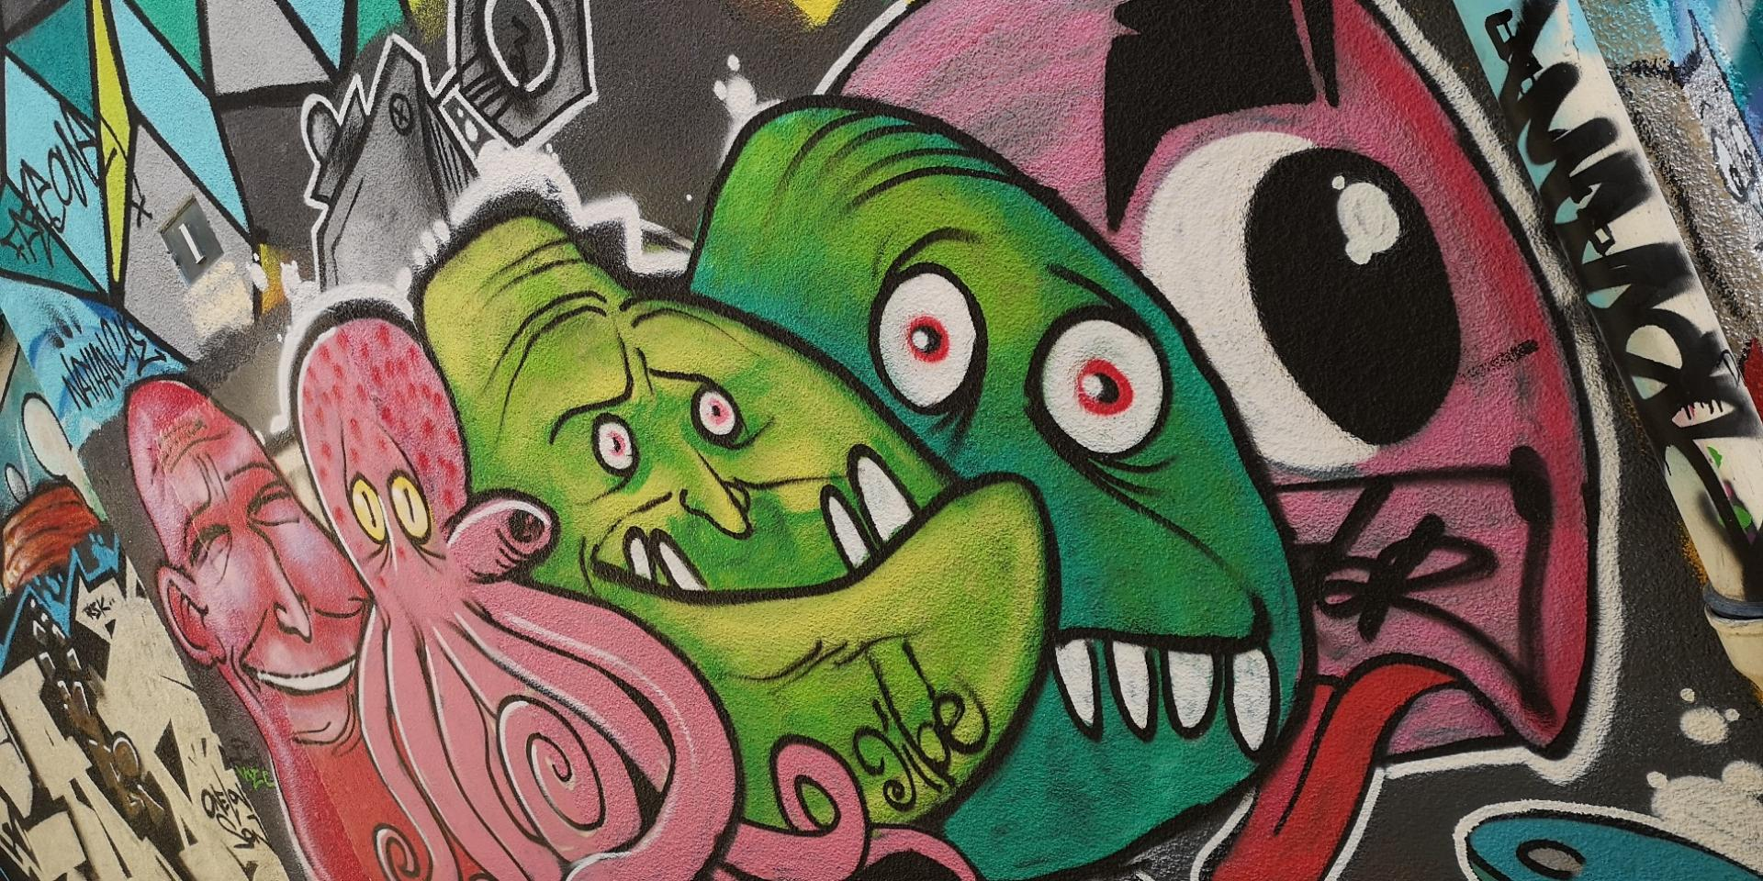

Slide 8
Legal means of plugging IP protection gaps
Neighbouring IP rights, e.g. trade mark
Contracts (e.g. with upstream suppliers / downstream distributors)
Trade secrecy (legally protected confidential information)
Bluffing / deterrence
Speed-to-market
Complementarity
Bundling
Know-how, tacit knowledge
Business strategy

Slide 9
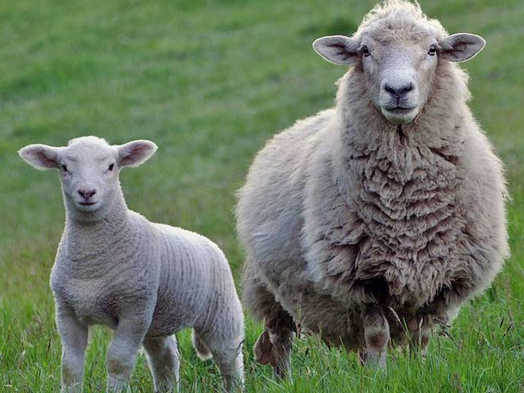
Commons and its tragedy
Free rider
Free rider
Nonexcludable
Nonrival
Open to undifferentiated public
Free rider
Free rider

Slide 10
So, solution?
We could give everyone private rights over a portion of the resource.
How will they coordinate use?
Free market will allocate efficiently (Ronald Coase).
What are some reasons it might not work out?
Difficult to partition resource
Impossibility to contract
Transaction costs
transact
Person B
(resource)
Person A
(resource)
Person C
(resource)

Slide 11
Common-Pool Resources (Elinor Ostrom 1990)
Share a clearly defined resource
Users have a stake
Users can access rulemaking
Sanctions for rulebreakers
Could this apply to cultural commons?

Slide 12
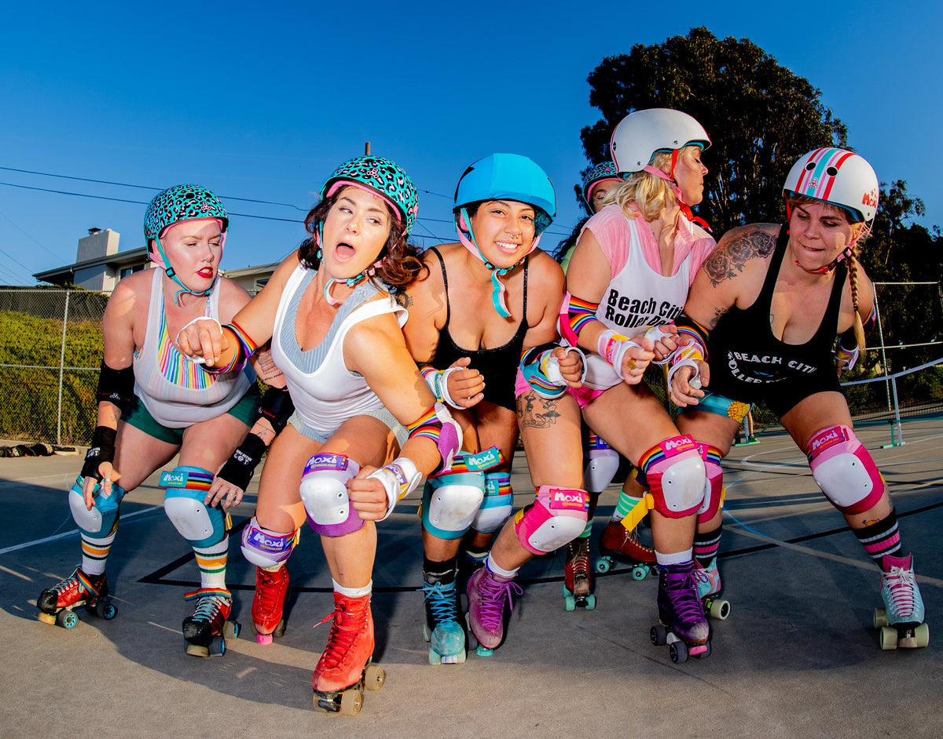
Bottom-up registries
Legal theorists love them!
David Fagundes, series of articles on clown eggs and roller derby competitor names.
Formal protection might plausibly apply. But instead,
“norms-based governance of IP”
Membership in an association, e.g. Clowns International
Exclusion and non-exclusion functions
Community resource
Signal of professionalism
Historical commons

Slide 13
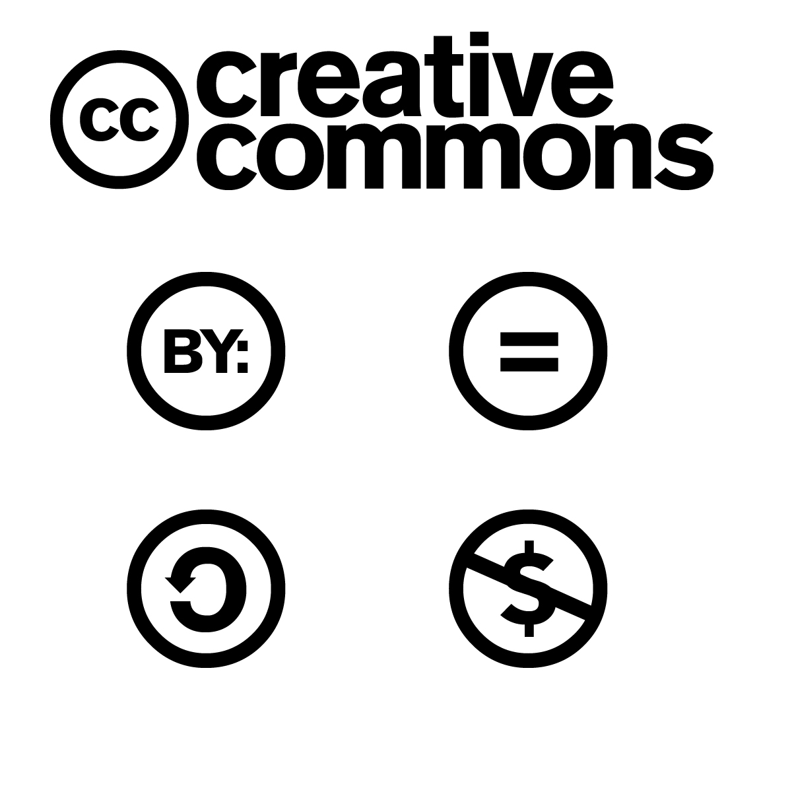
A legal innovation:
Free and Open source Software /
Creative Commons
Are legal innovations to solve the coordination problems raised by peer-production:
Define acceptable use by group members;
Promote follow-on innovation by reducing transaction costs;
Prevent appropriation / private rights, which would lock out collaborators;
Solidify norms with legal certainty.

Slide 14
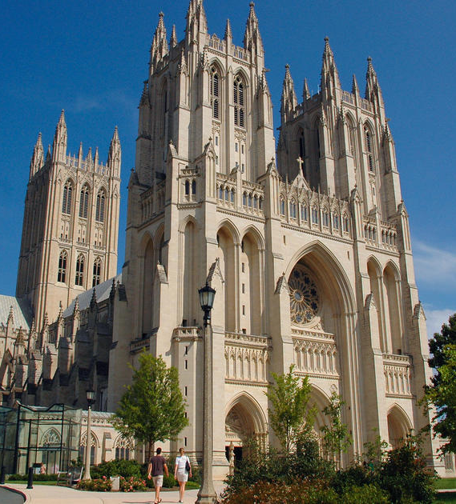
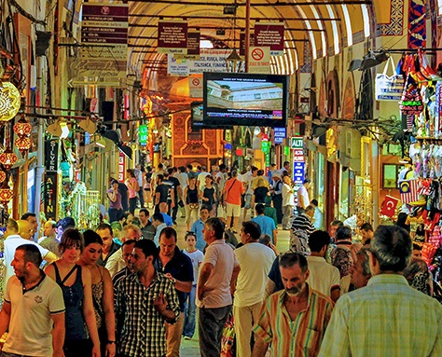
The Cathedral and the Bazaar
Eric Raymond’s (1998) essay on the benefits of open source software.
“Linus Torvalds's style of development - release early and often, delegate
everything you can, be open to the point of promiscuity”
"Given enough eyeballs, all bugs are shallow.”
Users are co-creators.
Where developers are not territorial about their code, improvement happens dramatically faster.

Slide 15
Part 2: Examples of Open Innovation
Firms that take inbound open innovations from upstream
Firms that “reveal” their innovations in an open way to users downstream

Slide 16
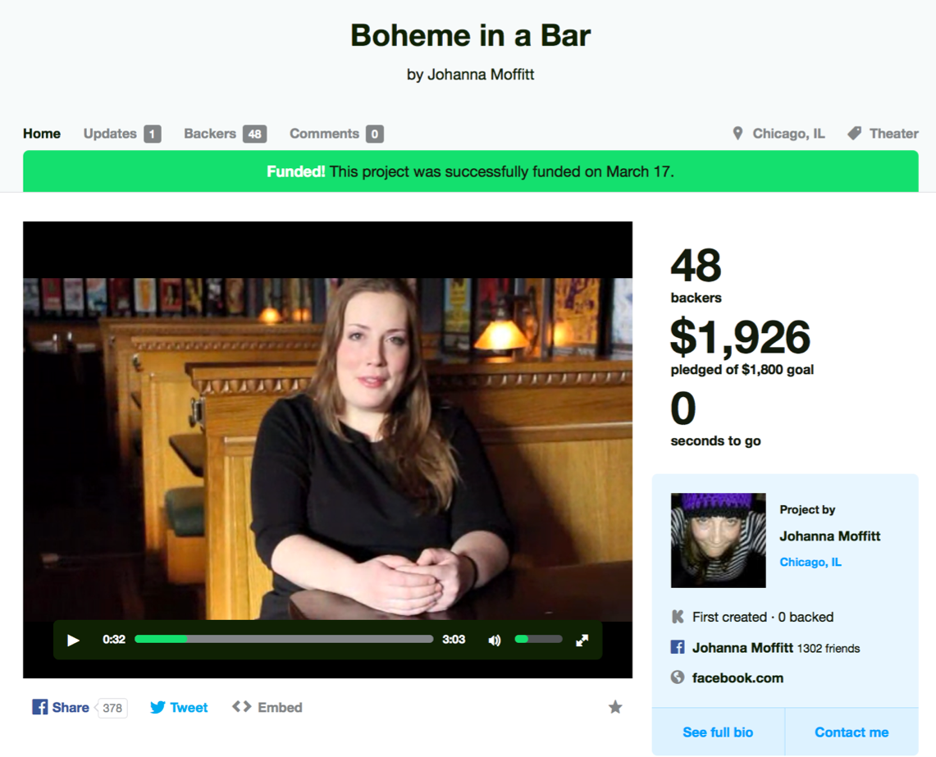
Example: Kickstarter and crowdfunding
Established 2010.
‘Rewards-based’, ‘all-or-nothing’ model.
Products include: film, theatre, comics, publishing & video games among others.
Largest rewards-based crowdfunding platform with $2.5 billion USD funding raised since 2010.

Slide 17
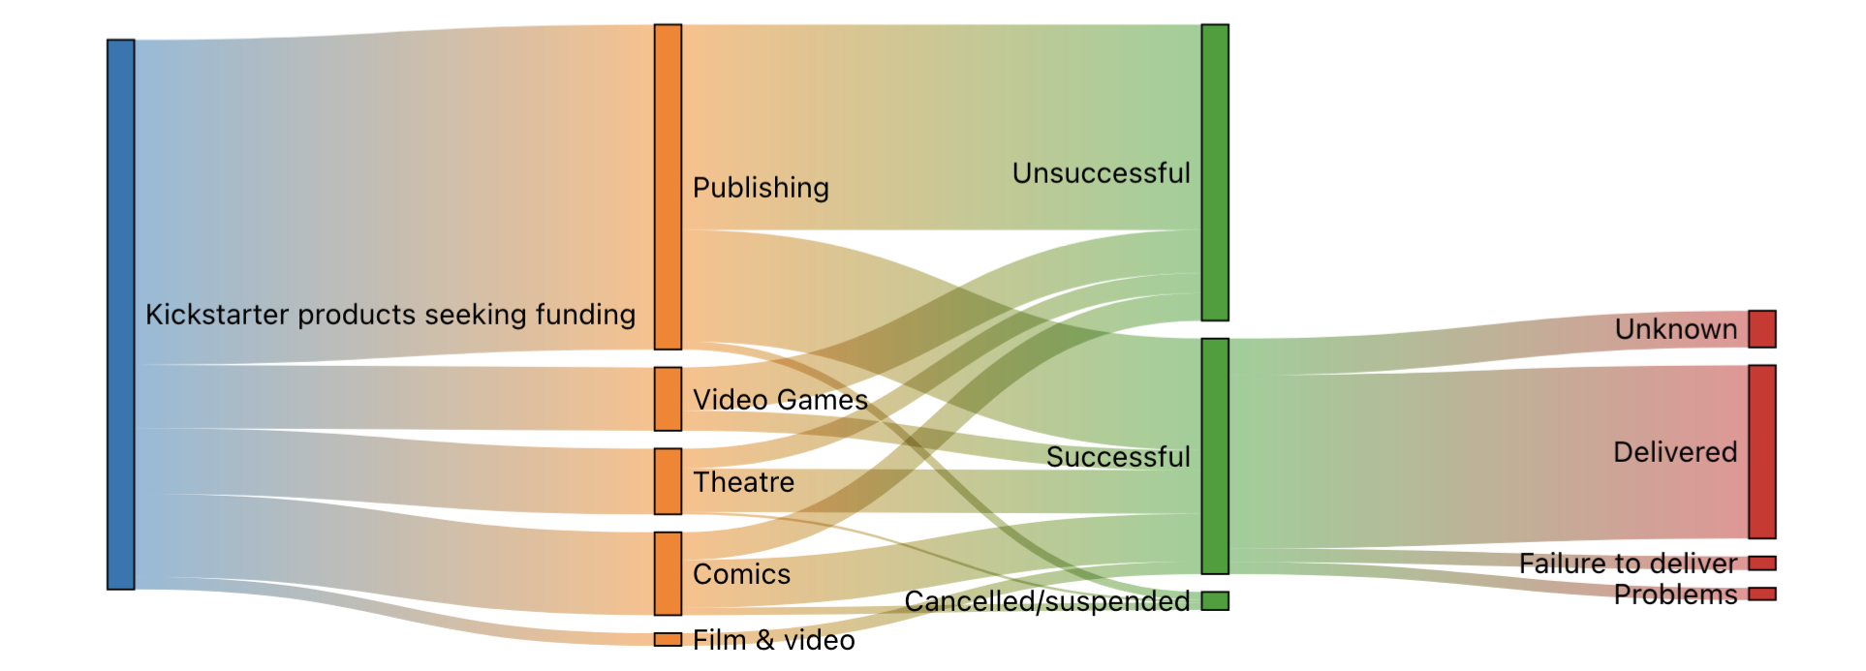
Study: Kickstarter and crowdfunding
Erickson, Homberg and Kretschmer, 2024. Forthcoming in Technological forecasting and Social Change

Slide 18
Methods
Main variables:
Success (1), Failure (0)
Cost of creation: Amount funds requested in GBP (logged)
Other variables of interest:
Media type: comics, theatre, video games, publishing
Main source of IP: original, transformed, Public Domain , 3rd party copyright
Previous experience of creator: none, some, known to backers, highly relevant

Slide 19
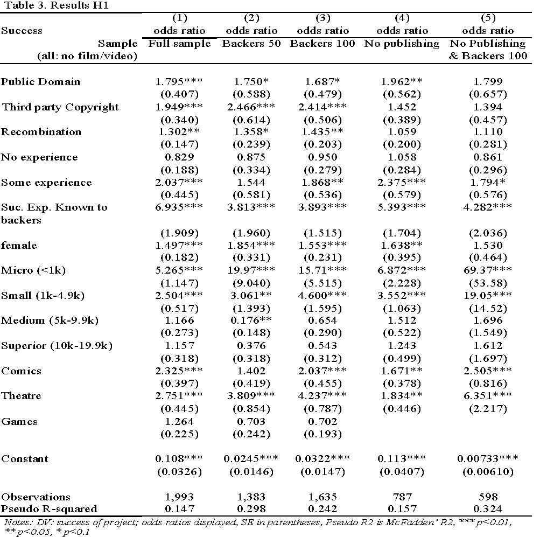

Slide 20
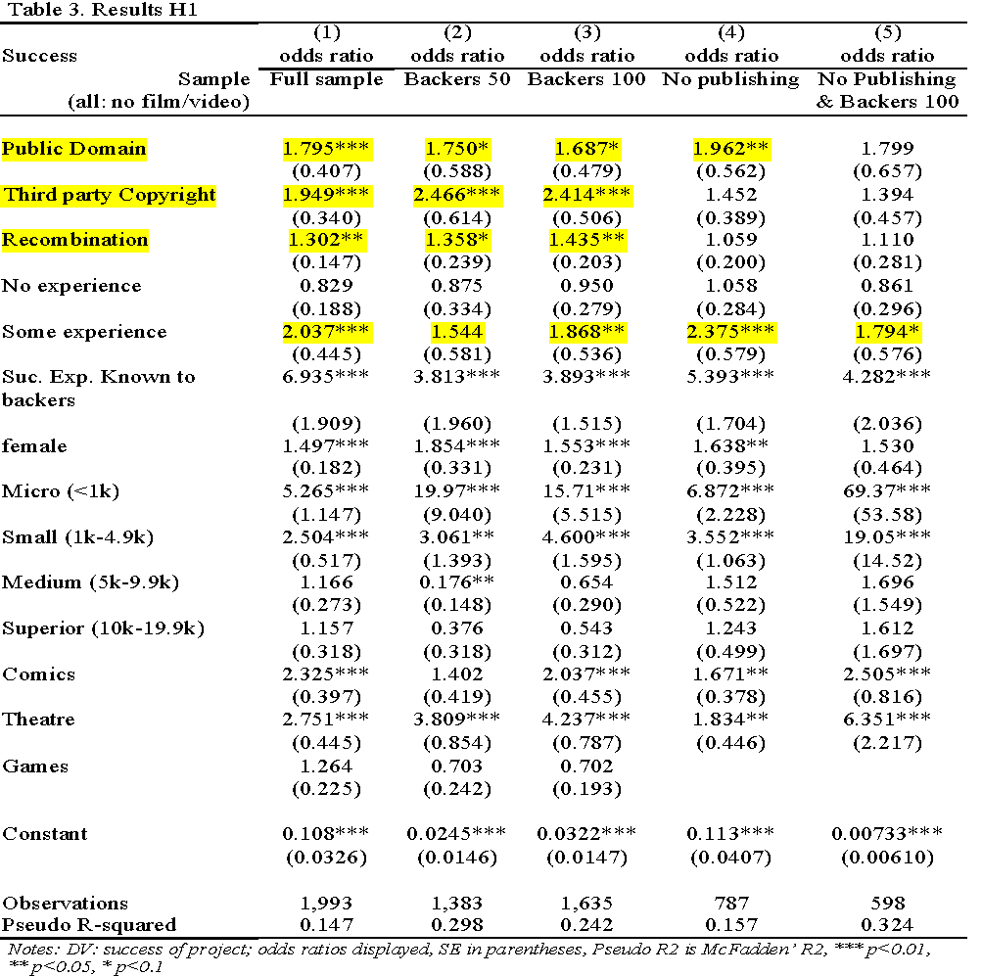

Slide 21
Benefits of inbound open innovation
Speed to market
Lower cost of production
Interoperate/connect with existing consumer base
Reduce risk in hits-driven markets “Nobody knows…”
Signal to consumers

Slide 22
Costs of inbound open innovation
Search and bargaining costs of seeking permission
License fees paid to rightsholder
Integration costs, “Not invented here” syndrome
Penalty for lack of originality? (Hill & Monroy-Hernández 2013; Lanbrecht, 2017)
In non-exclusive cases, competition from other users

Slide 23
Type 2: Downstream openness to user community
Can firms gain benefit from giving away their IP for free?

Slide 24

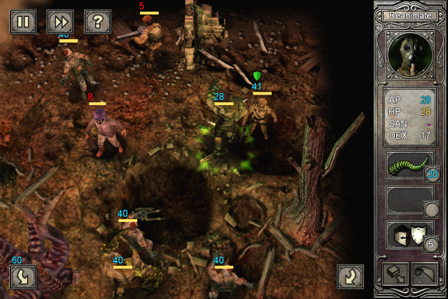

Slide 25
“If a public domain story has nothing interesting done to it, and people just kind of venerate it, it essentially traps it in amber. I think it is important that you’re growing something for fans, because obviously they want to see more stuff come out. When they don’t get it they’ll make it themselves, and where they do get it, they’ll make it themselves anyway, but more so.”
Red Wasp Design

Slide 26
Open Product Development: Distributed Value Chain
IDEA
GENERATE
MARKET
RELEASE
RELEASE
RELEASE
RELEASE
END
CONSUMER
Users

Slide 27

Case example: Kerbal Space Program
Initiated in 2010 by Felipe Falanghe at Mexico City ad agency;
V0.73 June 2011 V0.90 beta December 2014;
Left Steam Early Access 27th April 2015;
Sold 1,149,000 copies before retail release!

Slide 28
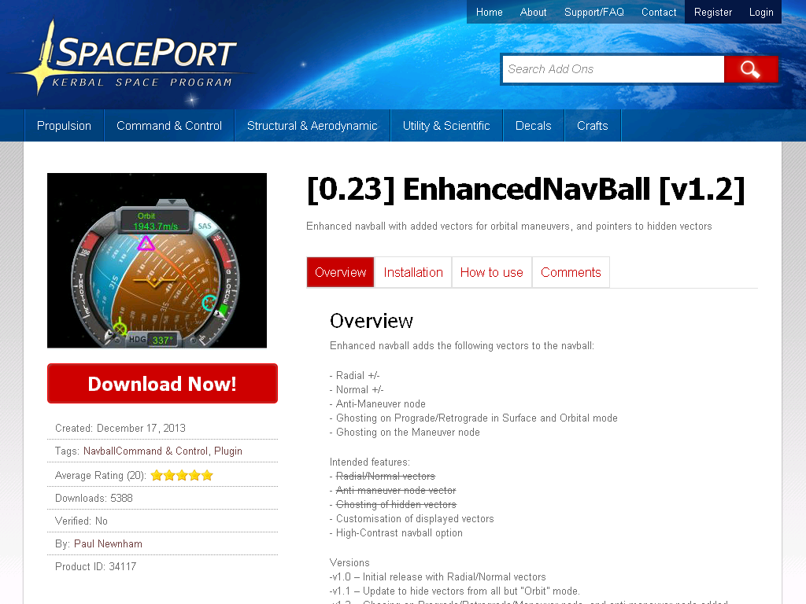

Slide 29
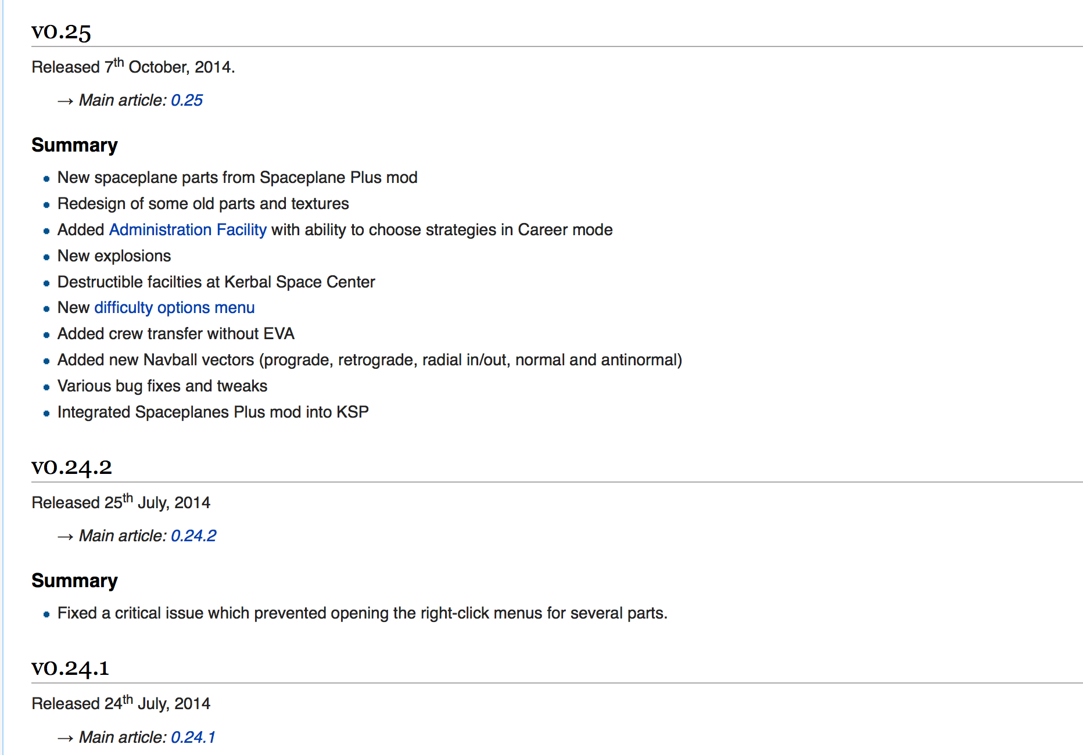

Slide 30
Commons-based Volunteer Activities
Procurement
Open IP status facilitates more use
Generation
Radically open creative firms
Marketing
Distribution
Commons-based Volunteer Activities

Slide 31
Part 3: Business Model Scenario Challenge
We will explore the dilemma of open vs closed business models with a live scenario
Your group will be responsible for coming up with a plan to generate and capture value from an open innovation:
An open-source autonomous vacuum device

Slide 32
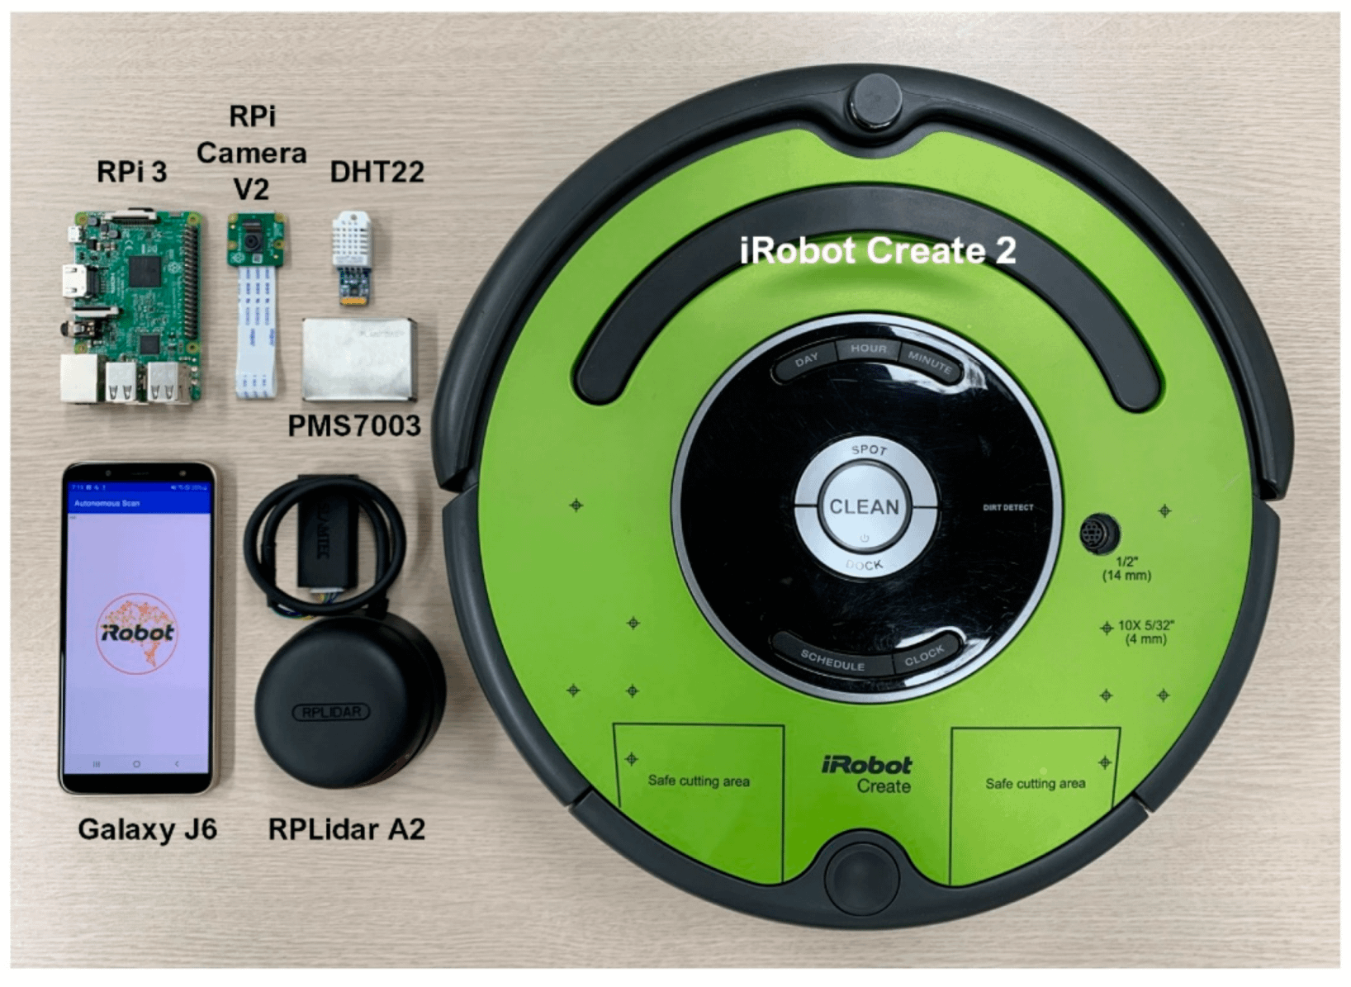
What you start with:
You have developed an open hardware autonomous vacuum cleaner (Open Rumba).
You have improved existing designs to provide customizability (mods) and more privacy-centric software (no cloud sharing required).

Slide 33
Details of license
The technology is covered by two different licenses:
Software: General Public License (GPL) 3.0 You have the the freedom to use the software for any purpose, the freedom to change the software, and distribute it. When redistributing versions of the software you have to grant the same rights to the subsequent users
Hardware Licence (CERN OHL) You are required to share the improvements when distributing the product. The documentation must accompany the hardware.
Bottom line: You have open access to the design files but so do all your competitors

Slide 34
The Task:
Come up with a business based on the vacuum
Who are your customers?
What value do you offer them?
How / when do they pay?
Typical business models:
Product-based (selling things)
Service (knowing things)
Platform (hosting things)
Match-maker (connecting things)

Slide 35
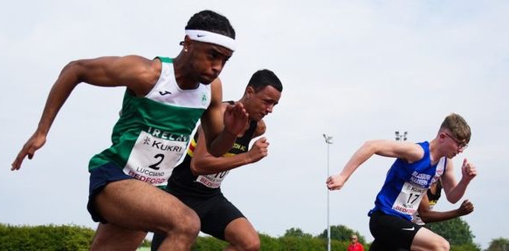
New challenge!
How would your group handle the following:
A competing firm is offering a cheaper vacuum with similar features that builds from your design!
What can your firm do to prevent “free riders” from competing?
What is your relationship with the open community?
Legal / contractual?
Informal social norms?
Competition / exclusivity?

Slide 36
Concluding thoughts:
What are advantages to firms opening their IP? What are some disadvantages?
To what extent should policy makers encourage open access to hardware / software?
Are private rights or open sharing better for stimulating new technology markets?
IP rights are not always first choice governance mechanism.
impose costs on co-creation
originate outside community norms

